Slide 1
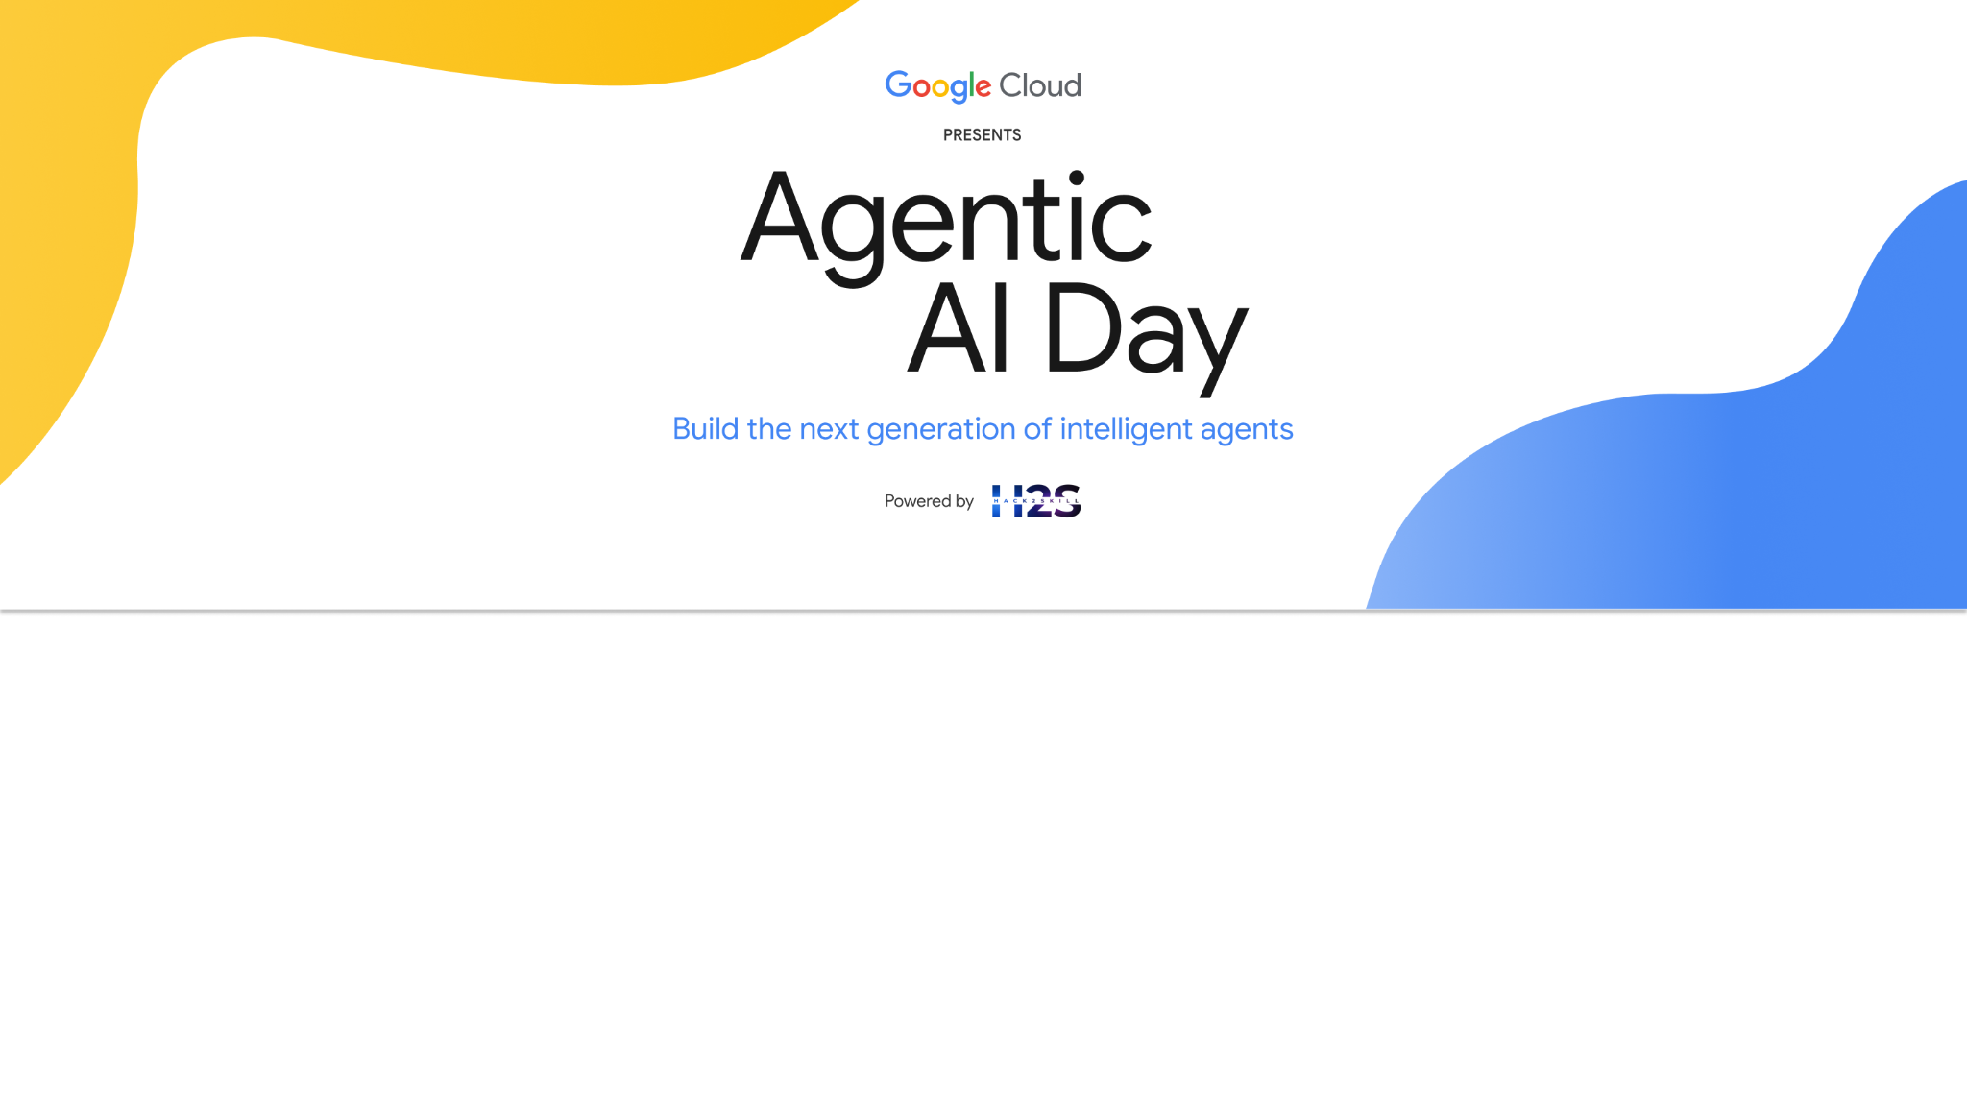
Team Details
Team name: NxtAgent5
Team leader name: Shilpa Shaw
Problem statement: Improving Safety at Large Public Events

Slide 2
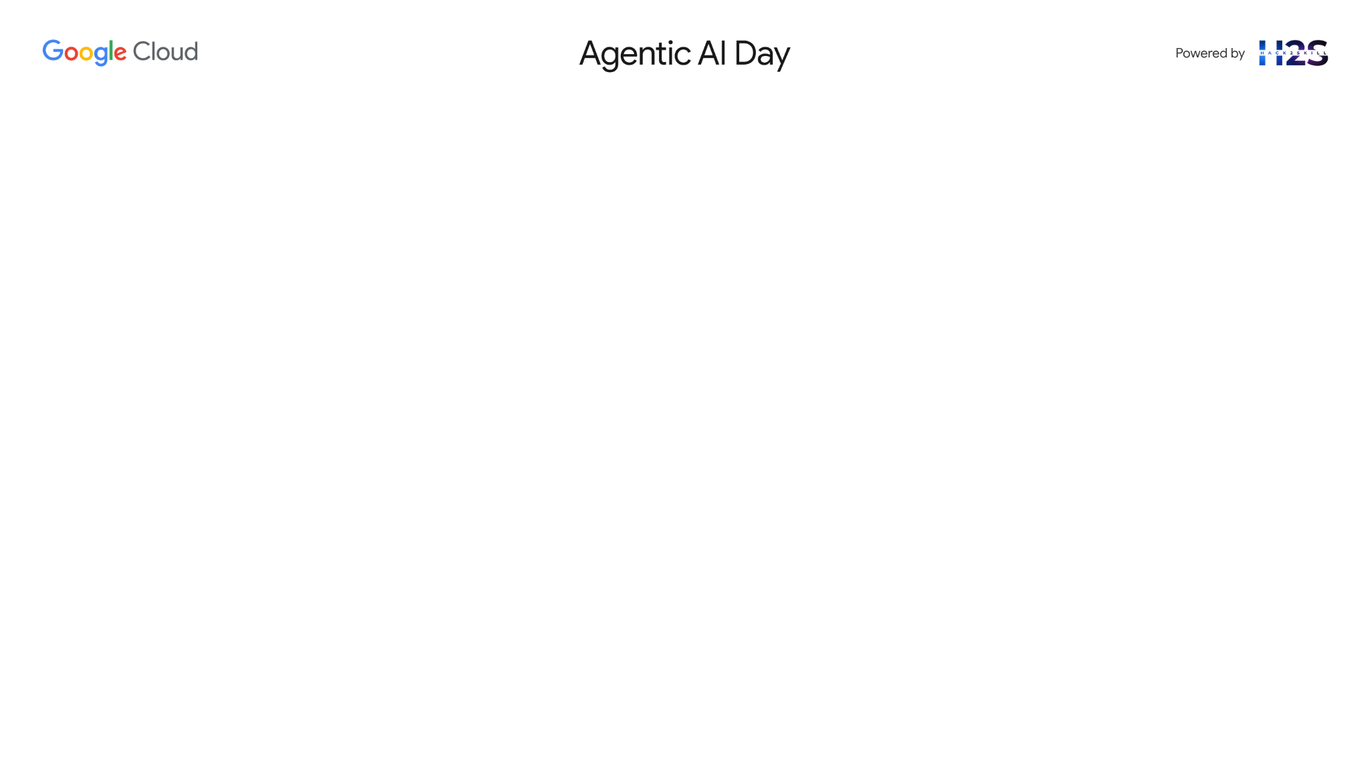
Brief about the idea
Problem: Large-scale events (e.g., Karaga, Tech Summits, NYE) face chaotic crowd movements, security blind spots, and slow emergency response due to lack of real-time insights and predictive tools.
Idea: Project Drishti is an AI-powered situational awareness platform built using Google Cloud tools. It acts as a central nervous system for event command centers—analyzing real-time crowd data, detecting anomalies, forecasting bottlenecks, and enabling instant, intelligent response.
Key Capabilities:
Crowd Flow Prediction using Vertex AI Vision + Forecasting
AI Summarization via Gemini for command queries
Smart Dispatching of responders/drones using Agent Builder + Google Maps
Lost & Found via facial recognition
Anomaly Detection (e.g., smoke, panic)
Sentiment & Simulation Agents for proactive intervention
Goal: Empower event organizers, police, and emergency teams with AI-driven foresight, not just hindsight.

Slide 3
Opportunities
How different is it from any of the other existing ideas?
How will it be able to solve the problem?
USP of the proposed solution
Unlike conventional surveillance or reactive monitoring systems, Project Drishti is a fully integrated, multimodal AI situational awareness platform built on Google AI tools. While existing solutions focus on post-event analytics or manual surveillance, Drishti proactively predicts, summarizes, and responds to threats in real-time.
In Bangalore, where events like Aero India, Bangalore Tech Summit, and large-scale music festivals (e.g., Echoes of Earth) attract massive crowds, existing systems fall short in managing fluid crowd dynamics and real-time anomaly detection. Drishti offers AI-powered decision-making, natural language interfaces, and intelligent drone coordination — a leap beyond static dashboards or siloed systems.

Slide 4
USP of the proposed solution
End-to-End Fusion AI Agent: Integrates computer vision, geospatial reasoning, natural language understanding, and social signals — all in real-time.
Explainable AI Trust Meter: Builds transparency into safety-critical decisions with confidence scoring using XAI.
What-If Simulation Engine: Run hypothetical crowd movement scenarios to make layout and resource planning smarter.
Operator Override Loop: Human-in-the-loop design ensures control stays with commanders during uncertain situations.
Firebase Deployed, Real-time Ready: Live app updates, alerts, and dashboards built on Firebase Studio with seamless backend integration.
Designed for Bangalore: Tailored to manage the unique crowd patterns, traffic congestion, and multilingual diversity of India’s most dynamic city.

Slide 5
List of features offered by the solution
Fusion Agent: Combines inputs to detect anomalies, bottlenecks
Trust Meter: Uses Explainable AI to score confidence
Simulation Agent: Handles "What-if" queries via simulation engine
Lost & Found Agent: Face/photo matching from uploads
Sentiment Agent: Aggregates mood from text/audio
Override Agent: Accepts operator feedback (Human-in-the-Loop)
Drone Agent: Optimizes drone dispatch using OR-Tools

Slide 6
1. Fusion Agent (Multimodal Anomaly Detection)
Purpose: Combine video, audio, and social media to detect anomalies (fires, fights, surges). Tech Stack:
Models:
Gemini 1.5 Multimodal (for zero-shot anomaly detection):
Prompt: “Analyze this image + audio clip. Return ‘high risk’ if fire, violence, or panic is detected. Explain why.”
Vertex AI Vision (pre-trained models):
Object detection (smoke, fallen people).
Optical flow for crowd velocity.
Data Fusion:
Use Vertex AI Pipelines to align timestamps from video/social media.
Cloud Pub/Sub streams real-time alerts. Innovation: Flags never-before-seen anomalies (e.g., novel crowd behaviors).

Slide 7
2. Trust Meter (Explainable AI)
Purpose: Quantify AI confidence and learn from human feedback. Tech Stack:
Models:
Vertex AI Explainable AI (XAI) for confidence scores (0–1).
Gemini generates plain-English explanations (e.g., “Low confidence (0.4) due to foggy camera.”).
Feedback Loop:
Operator corrections stored in Firestore.
Daily fine-tuning via Vertex AI Training. Innovation: Only alerts commanders when confidence > threshold (reduces false alarms).

Slide 8
3. Simulation Agent ("What-If" Scenarios)
Purpose: Predict crowd reactions to changes (e.g., gate closures). Tech Stack:
Models:
Agent-based modeling (Python Mesa library) simulates crowd movement.
Vertex AI Forecasting predicts bottleneck timing.
Integration:
Live data from Vertex AI Vision fed into simulations.
Outputs visualized in Google Maps API (animated heatmaps). Innovation: Natural language queries (Gemini) → simulation params (e.g., “Simulate rain at 3PM”).

Slide 9
4. Lost & Found Agent (Privacy-Preserving Matching)
Purpose: Match uploaded photos to live feeds without storing PII. Tech Stack:
Models:
Vertex AI Vision’s Face Detection (not recognition) extracts embeddings.
Private Set Intersection (PSI) compares embeddings on-device.
Workflow:
Attendee uploads photo → hashed locally.
Hashes compared to live feed hashes (Firebase ML Kit).
Match? → Notify only the attendee. Innovation: GDPR-compliant; no raw images stored.

Slide 10
5. Sentiment Agent (Crowd Mood Analysis)
Purpose: Detect panic, excitement, or boredom in real time. Tech Stack:
Models:
Audio: Google’s Speech-to-Text → Gemini for emotion classification (e.g., “Crowd noise: 70% panic”).
Text: Cloud Natural Language API analyzes social media posts.
Output: Sentiment heatmap overlaid on Google Maps. Innovation: Combines acoustic + textual sentiment for accuracy.

Slide 11
6. Override Agent (Human-in-the-Loop)
Purpose: Let operators correct AI and improve future predictions. Tech Stack:
Tools:
Firebase Realtime DB logs overrides (e.g., “False alarm: fireworks, not gunshots”).
Vertex AI Data Labeling retrains models weekly.
Interface:
Simple Google Forms-like UI in Firebase Studio for feedback. Innovation: AI adapts to event-specific false positives.

Slide 12
7. Drone Agent (Autonomous Swarm)
Purpose: Optimize drone paths for incident response. Tech Stack:
Models:
OR-Tools (Google’s optimization library) for route planning.
TensorFlow Lite on drones for edge-based anomaly detection.
Integration:
Drones stream to Vertex AI Vision via Cloud IoT Core.
Maps API avoids airspace conflicts. Innovation: Lightweight edge AI reduces cloud bandwidth by 90%.

Slide 13
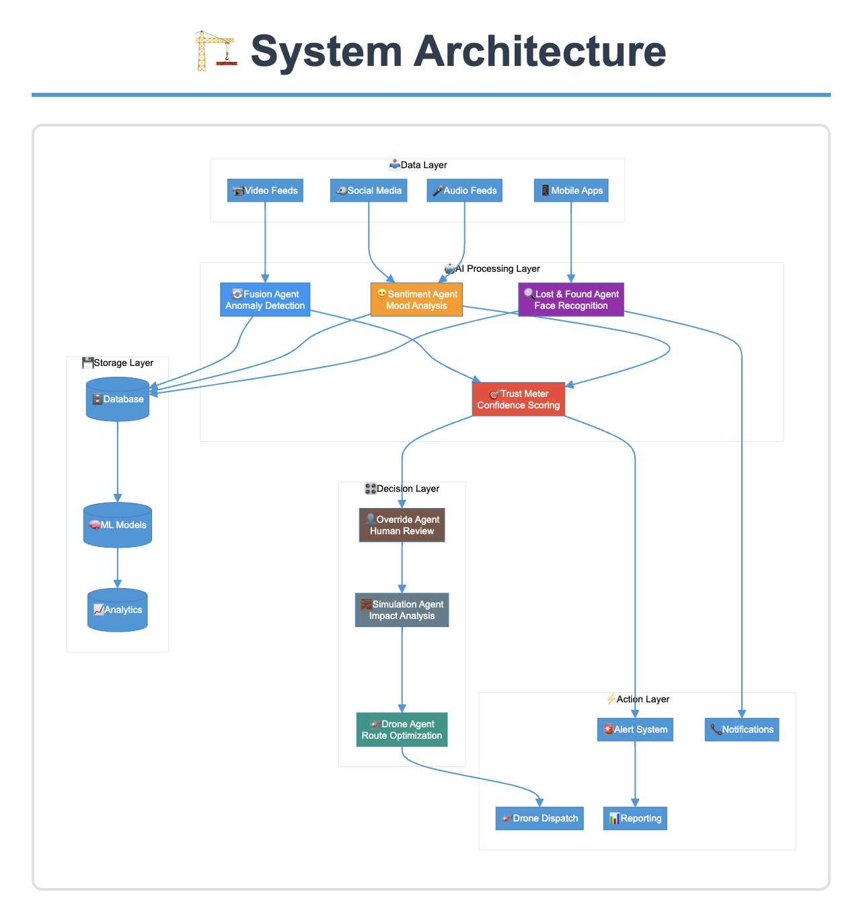
Process flow diagram or use-case diagram

Slide 14
Technologies to be used in the solution
Core Google Cloud Technologies
AI/ML Models
Gemini 1.5 Multimodal
Anomaly detection (video/text/audio fusion).
NLP for operator queries ("Summarize West Zone risks").
Zero-shot novel event detection.
Vertex AI Vision
Crowd density/flow analysis (optical flow, object detection).
Face embedding extraction (for Lost & Found).
Vertex AI Forecasting
Time-series prediction of bottlenecks (LSTM/Prophet).
Vertex AI Pipelines
Retrain models with operator feedback (meta-learning).
Cloud Natural Language API
Sentiment analysis of social media/text.

Slide 15
2. Data & Compute
Firebase
- Realtime DB: Track responder GPS locations.
- Cloud Messaging: Push alerts to staff/attendees.
- Hosting: Deploy web dashboard (special prize requirement).
- Authentication: Secure attendee app logins.
Cloud Pub/Sub
- Stream video/social media alerts in real time.
BigQuery
- Log incidents for post-event analytics.
Cloud Run
- Serverless deployment of agents (auto-scaling).

Slide 16
Maps & IoT
Google Maps Platform
Geofencing, heatmap visualization, route optimization.
Cloud IoT Core
Manage drone swarm connections.

Slide 17
Optimization & Edge
OR-Tools
Drone path optimization + responder dispatch.
TensorFlow Lite
Edge AI on drones for video pre-processing.

Slide 18
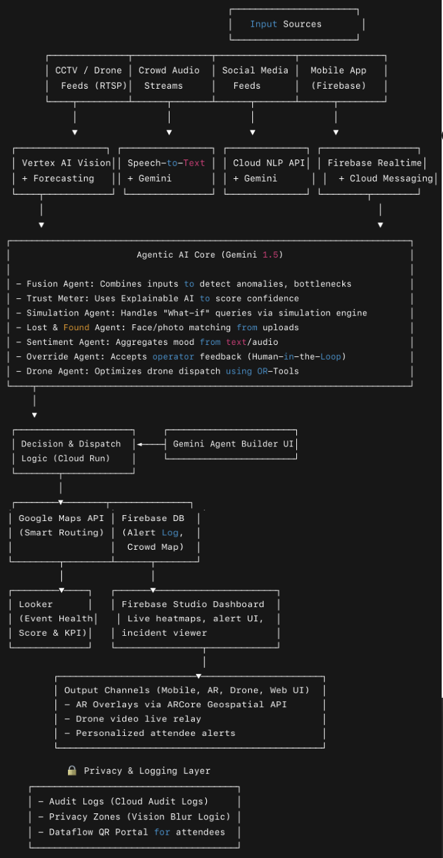
Architecture diagram of the proposed solution

Slide 19
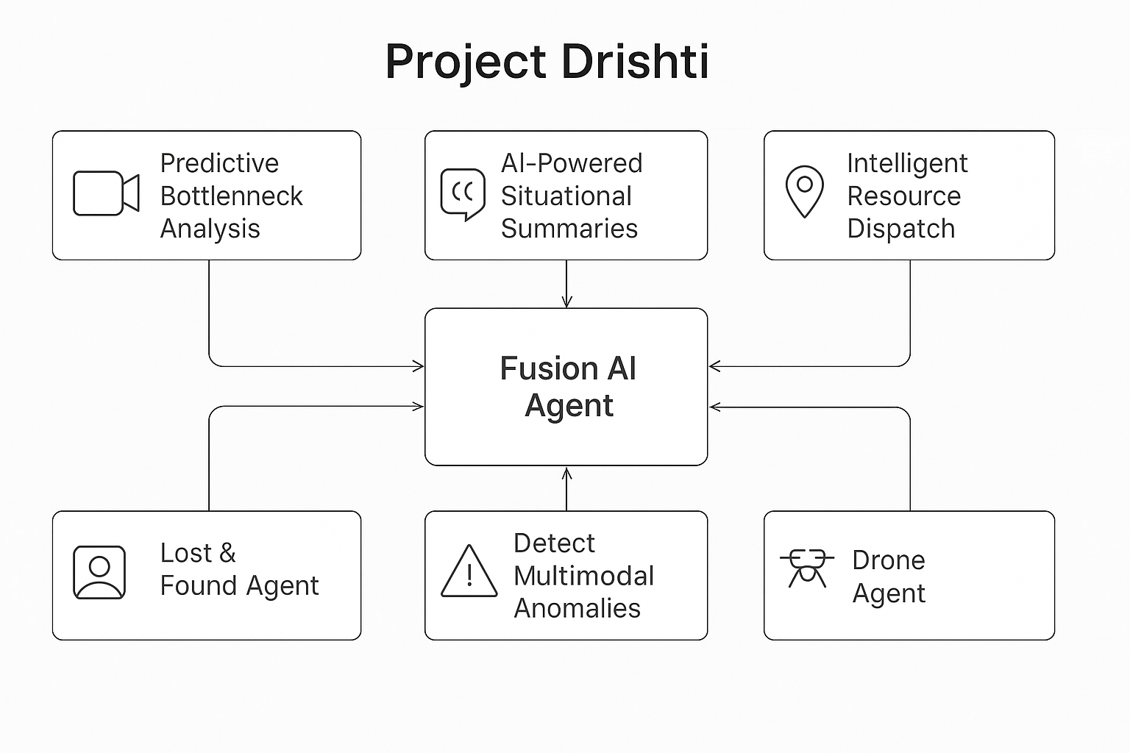
Wireframes/Mock diagrams of the proposed solution (optional)

Slide 20
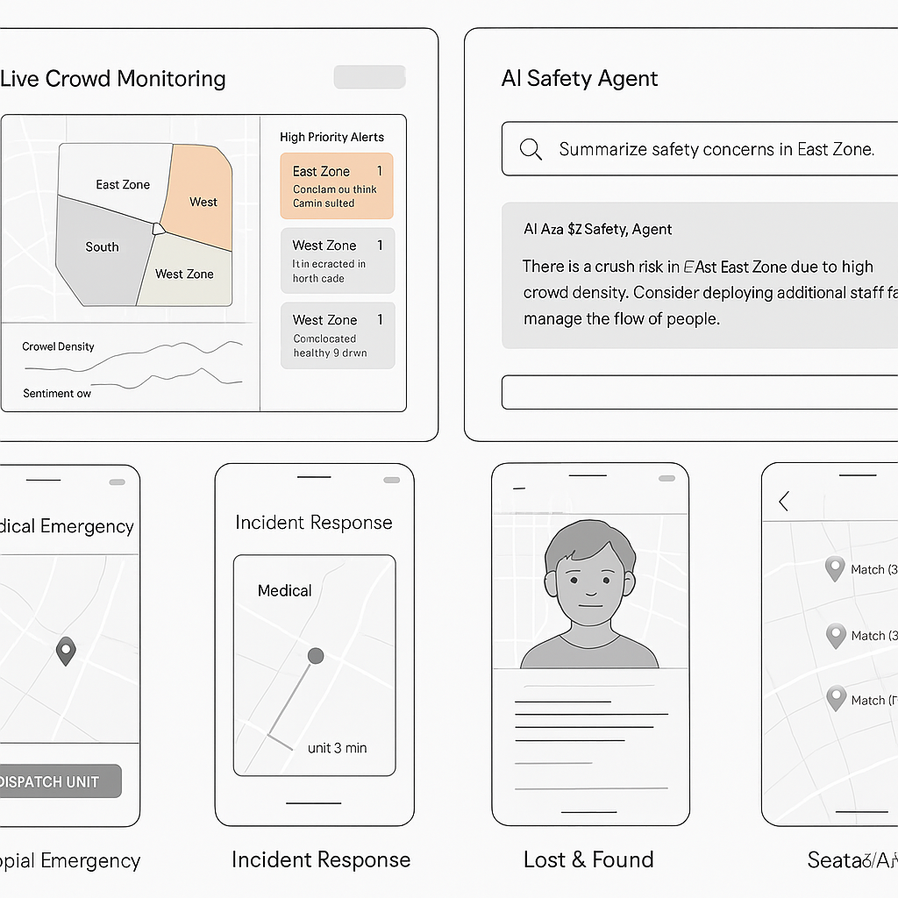

Slide 21
